Slide 1
Data Mining 2 Supervised Learning
AI Architecture
Dr. Shailesh Kumar
ISB/CBA

Slide 2
AI Architecture – Stimulus-Response-Learn
Which is the most important “silent” innovation in ML in the last two decades?
STIMULUS
(sense)
FEEDBACK
(measure)
RESPONSE
(realize)
ANALYZE
(understand)
LEARN
(improve)
SYNTHESIZE
(manifest)
STATE
(represent)
KNOWLEDGE
ACTION
(do)
Recognition
Interpretation
Summarization
Embeddings
Feature Engineering
Prediction
Recommendation
Reinforcement
AI-search
Optimization
REASON
(think)
GOAL

Slide 3
FEEDBACK – The “silent” innovation in AI
“If you don’t know where you want to go, then any path will take you there”
– Alice in Wonderland
The quality of the feedback determines the quality of your models
Which search result for which query by whom in what context?
How long did they stay on that page? Is there a position bias?
Feedback need not just be binary or single stage
Did they click the top recommended video?
What fraction of that video they watched?
Same Entity Multiple degrees of Implicit Feedback
What did you search, browse, read/write-review, Wish-list, Buy?
What did you buy in same visit, in recent visits, for same address?

Slide 4

SIGNAL – STATE – METRICS – ACTIONS loop
Concept Understanding
Concept Application
Silly mistake propensity
Test taking behavior
S T A T E
What do the signals mean?
Curriculum Personalization
Content Recommendation
Practice Problem Recommendation
Personalized Test Generation
S I G N A L S
What do/should I sense?
A C T I O N
What should I do?
Time spent on content
Problems practiced
Problems done right/wrong
Hints / Questions asked
Time taken to solve problem
Steps used to solve problem
Make Learning Efficient
Make Practice Efficient
Improve Test Scores
Minimize Silly Mistakes
Increase Test taking speed
M E T R I C S
Where do we want to be?

Slide 5
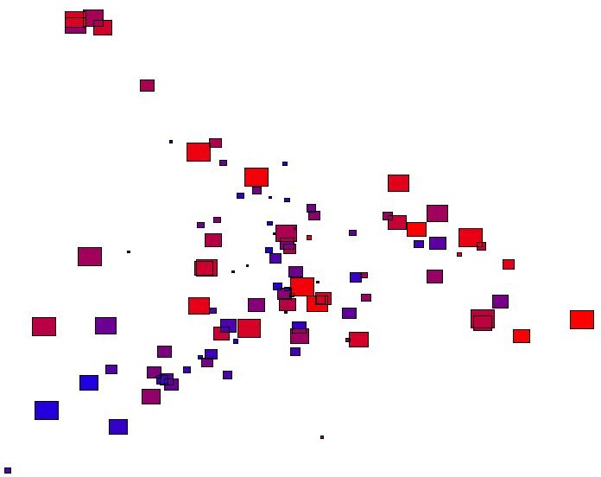
SUMMARIZATION Algorithms
DRAMA
ACTION
COMEDY
SCI FICTION
XBOX SOFTWARE
XBOX HARDWARE
XBOX CONTROLLERS
XBOX MISC.
XBOX PLATINUM HITS
GAMECUBE SOFTWARE
GAMECUBE HARDWARE
GAMECUBE CONTROLLERS
GAMECUBE MEMORY
GAMECUBE MISC.
MEMORY
INTERNAL HARD DRIVES
GRAPHICS
PC COMPONENTS
ACTION
TELEVISION
DRAMA
COMEDY
ANIME
ROCK/POP
FAMILY
PLAYSTATION 2 SOFTWA
PS2 GREATEST HITS
PLAYSTATION 2 HARDWR
PLAYSTATION 2 MEMORY
PLAYSTATION 2 MISCEL
PLAYSTATION 2 CONTRO
LCD MONITORS
CPU'S
INK JET PRINTERS
CABLES/CONNECTORS
MULIFUNCTION PRINTER
DISHWASHER
TOP MOUNT REFRIG
DISHWASHER INSTALL
MAJOR APPL. ACCESS.
GAS RANGES
ELECTRIC RANGES
ICEMAKERS
MAJOR APPL. ACCESS.
ELECTRIC DRYERS
WASHER
SIDE BY SIDE
ELECTRIC RANGES
TOP MOUNT REFRIG

Slide 6
SEMANTIC Algorithms
AMBIENCE
atmosphere
ambiance
decor
vibe
environment
relaxed_atmosphere
great_ambiance
nice_decor
very_trendy
laid_back_atmosphere
cozy_feel
dim_light
very_casual
cozy_atmosphere
modern_decor
low_light
music_play_in_background
garlic use on pizza wa tasty
sicilian sauce wa tasty
pizza though oi so yummy
even marinara chicken sandwich deliciou
eggplant parmesan wa deliciou
crust on frie chicken wa real good though
very yummy !! their garlic cheese bread awesome
probab one of worst meal ive ever had
thi wa most disgust place at which ive ever eaten
most unsatisfy place i have ever eaten
absolute worst service ive ever receive
would never ever go back
never ever again

Slide 7
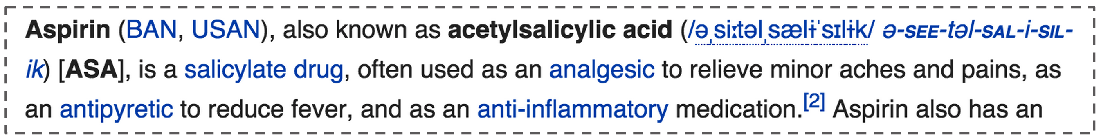
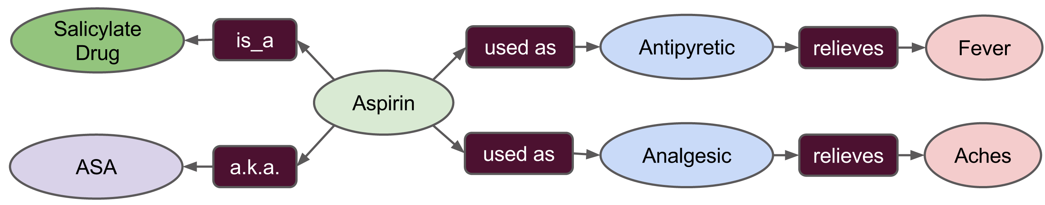
EXTRACTION Algorithms

Slide 8
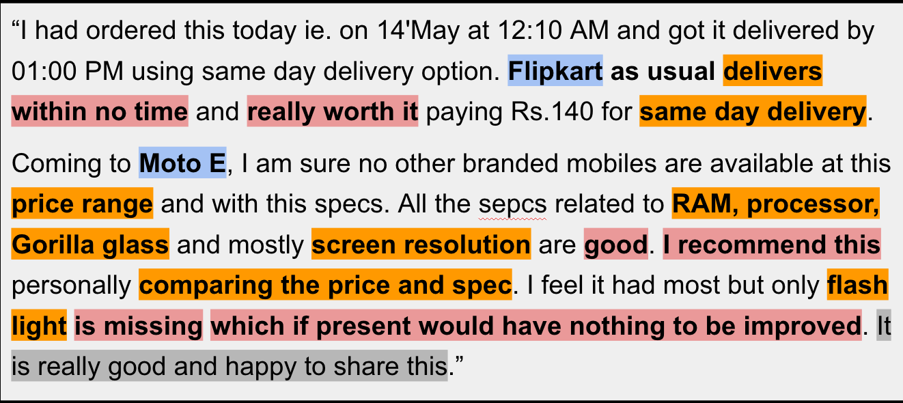
INTERPRETATION Algorithms
Entity
Aspect
Sentiment

Slide 9


PREDICTION Algorithms
Is this a FRAUDULENT transaction?
Am I being HACKED right now?
Is this customer about to CHURN?
What ACTIVITY is person doing?

Slide 10
RECOMMENDATION Algorithms
Which concept this student should LEARN?
Who will respond to this COUPON?
95
40
80
60
40
85
Is this the best RESUME for my job?
Student A
Student B

Slide 11
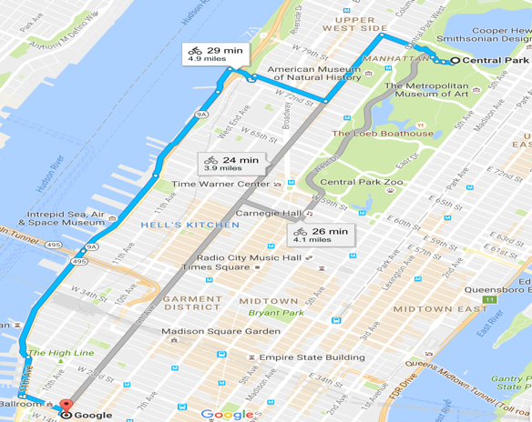
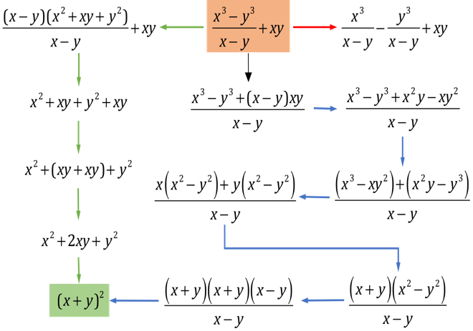
REASONING Algorithms
Which TURN should I take next?
What should I SAY next?
What TRANSFORMATION should I apply next?
Which MOVE should I play next?

Slide 12
Data Mining 2 Supervised Learning
EXPLORING DATA
Dr. Shailesh Kumar
ISB/CBA

Slide 13
From Data to Decisions…
Insights
Features
Domain Knowledge
Models
Data
Predictions
Decision
Business Objectives
Business Constraints
Feedback

Slide 14
Data comes in many forms and shapes and sizes!

Slide 15
Data Types
Numeric – a quantifiable number
Type – integer (e.g. age), floating (e.g. price), time, date, …
Stats – min/max/median/mean/…
Units – (C/F), (KG/Lb), (Meter/Feet), (Sec/Min/Hrs),
Distributions – exponential/uniform/…
Ordinal – not quantifiable but ordered
E.g. size = Small/Medium/Large/…
E.g. income bucket = Low/Medium/High/Wealthy/...
E.g. Relevance = Perfect/Excellent/Good/Fair/Bad/…
Symbolic – neither quantifiable, nor ordered
E.g. color = red/green/blue/…
E.g. state/country/region/…
E.g. weather = rainy/cloudy/windy/…

Slide 16
Data Organization
 | feaure-1 | feature-2 | feature-3 | feature-4 | feature-5
example-1
example-2
example-3
example-4
example-5
example-6
example-7
MULTIVARIATE
(rows (examples) of columns (features))
Low Dimensional and Dense
 | item-1 | item-2 | Item-3 | Item-4 … | item-10M
example-1 | 1 |  | 1
example-2 |  |  |  | 1 | 1
example-3
example-4 | 1 | 1
example-5 |  |  |  | 1
example-6 |  | 1 |  | 1
example-7 |  |  | 1 |  | 1
BASKET
(sets of things)
market basket, keyword list
High Dimensional and Sparse
 | item-1 | item-2 | feature-3 | feature-4 | item-100M
example-1 | 10 |  | 5
example-2 |  |  |  | 13 | 11
example-3
example-4 | 18 | 12
example-5 |  |  |  | 21
example-6 |  | 4 |  | 51
example-7 |  |  | 1 |  | 32
BAG
(weighted sets of things)
Bag-of-Words, Bag-of-Visual Words
High Dimensional and Sparse

Slide 17
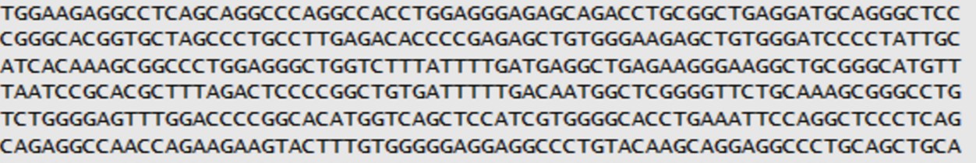
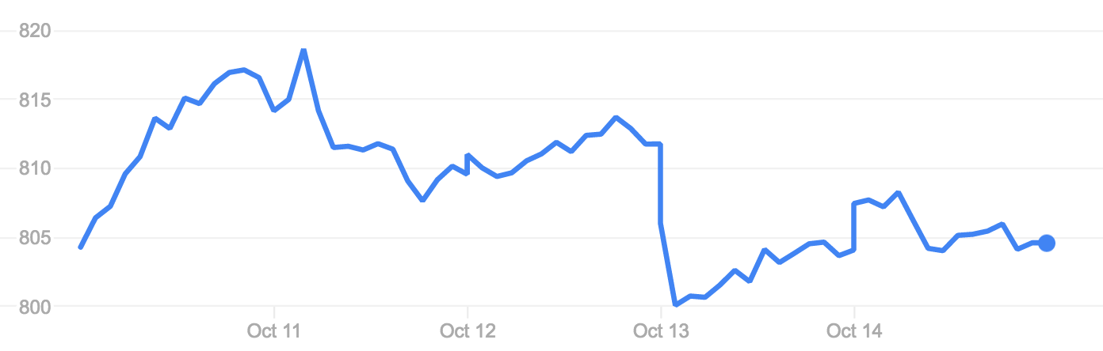
Data Organization
1-D SEQUENCE
(list of “symbols”)
Gene sequence, Text
1-D SERIES
(list of “numbers”)
Stock market, IoT data
2-D SERIES
(mage)
3-D SERIES
(videos)
4-D SERIES
(3-D videos)

Slide 18
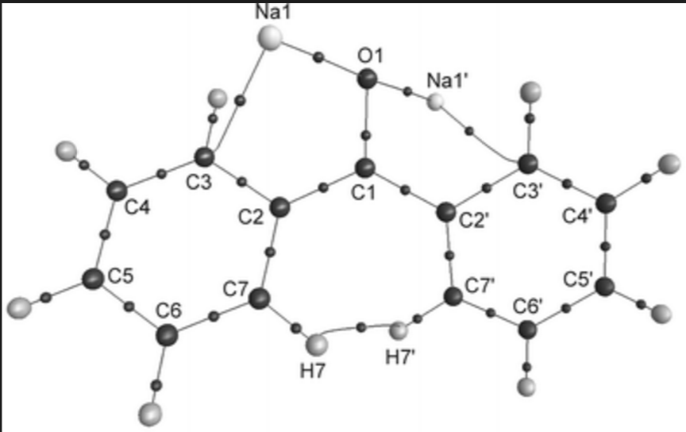
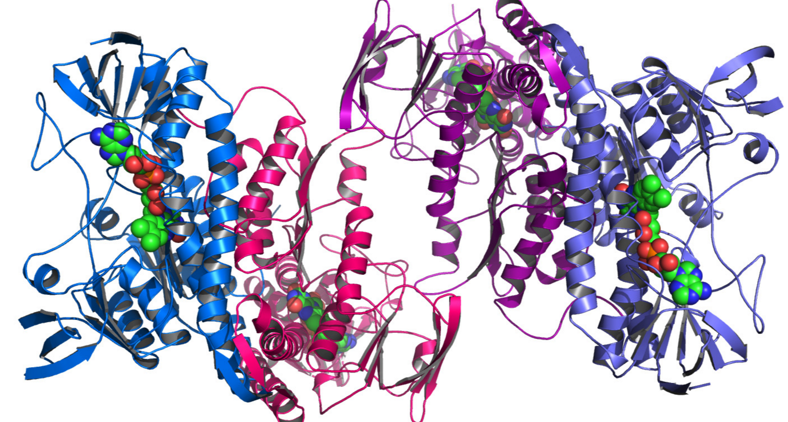
Data Organization
GRAPHS
(entities and relationships)
Chemical compounds
3-D SHAPES
(list of (x,y,z) coordinates)
Motion Sensors, Protein Structures

Slide 19
Data Modalities
STRUCTURED – fixed columns in a table
Multivariate data
Mix of numeric and symbolic features
UNSTRUCTURED -- Arbitrary size data points
SEQUENCE : biological, speech, …
SERIES : stock market, etc.
TEXT : pages, queries, tweets, ads, blogs, news, …
IMAGE : regular, medical, remote sensing,…
VIDEO : regular, movies, security, surveillance,…

Slide 20
Data Nuances

Slide 21
Data Nuances
FEATURE NOISE – value may not be accurate
Sensor Malfunctioning, Sensor Biased, Sensor Resolution,…
Call center notes, Transcription errors, Data entry errors
Comments → Tweets →Blogs → News → Scientific Papers
MISSING FEATURES – some feature values might be missing
Sensor went down, Communication/Storage failure, Human error
NON-NORMAL FEATURE DISTRIBUTIONS
Exponential, log-normal distributions are more common than normal
Taking log of features helps
HETEREGONEOUS FEATURES - ranges, scales, distributions.
E.g. Age, Income, Temperature, RBC Counts, Blood Pressure,…
MULTI-MODAL FEATURES
Mix of numeric, symbolic, series, text, and image PER data point!

Slide 22
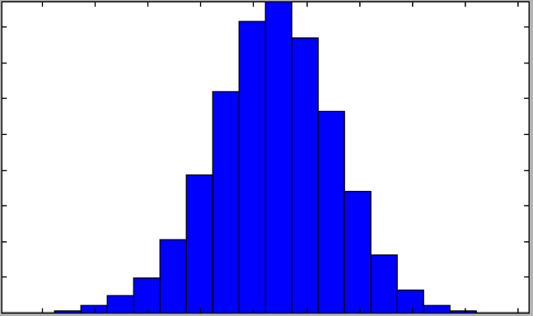
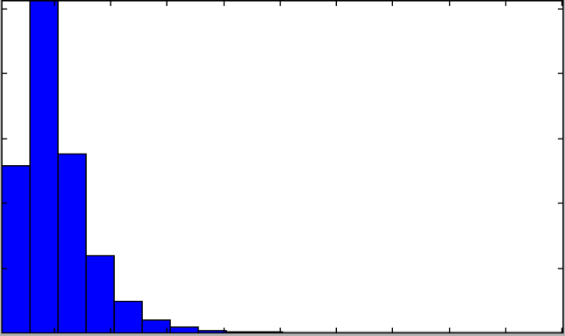
Not normal distributions!
log(feature)
feature

Slide 23
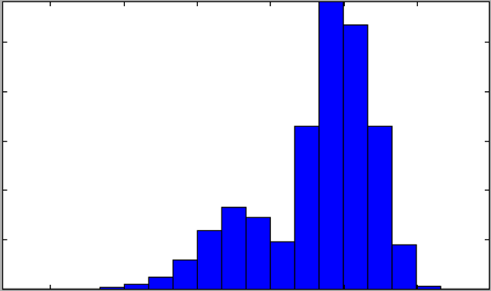
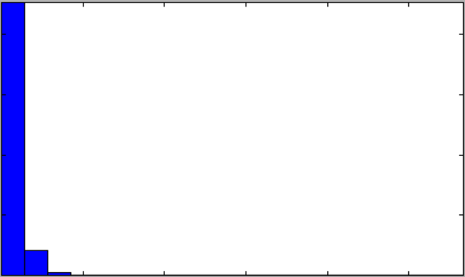
Hidden Treasures!
log(feature)
feature

Slide 24
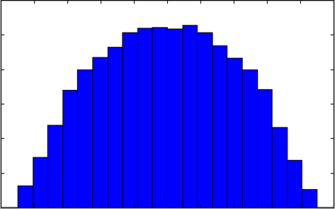
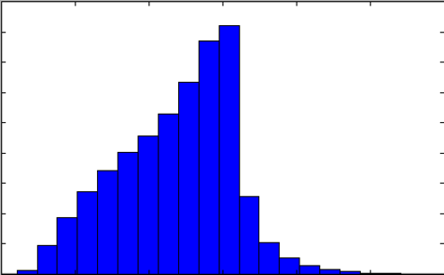
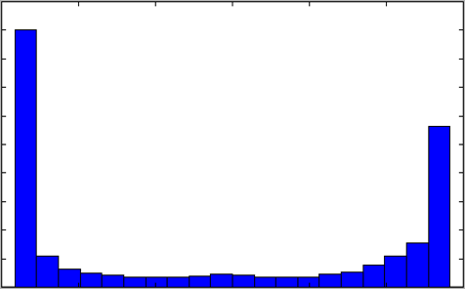
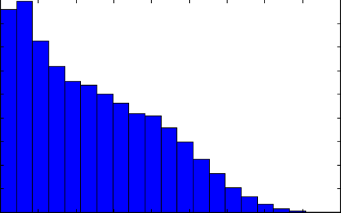
Heterogeneous Distributions CERN – Higgs-Boson Distributions! (Kaggel)

Slide 25
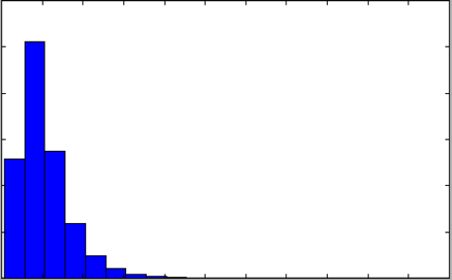
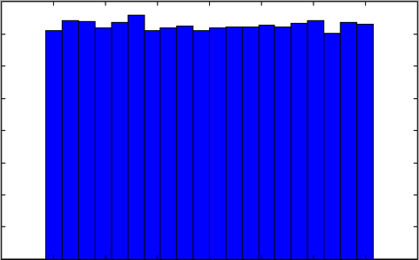
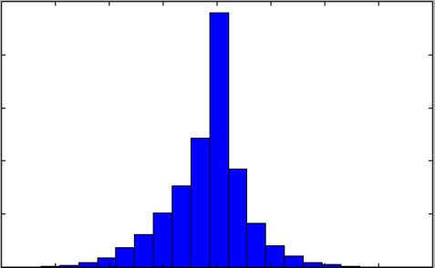
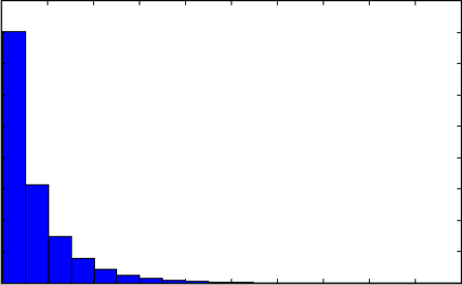
Heterogeneous Distribution CERN – Higgs-Boson Distributions! (Kaggel)

Slide 26
Class Nuances

Slide 27
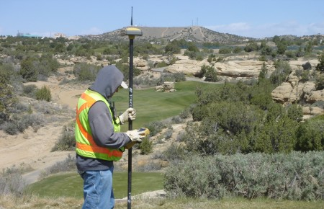
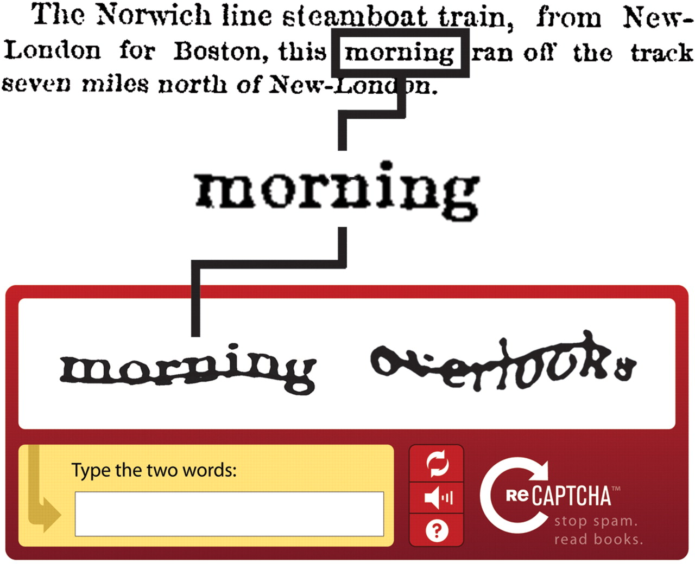
Label Data Nuances
Label data is sometimes costly
Remote Sensing – travel to the site
Astronomy – line of sight is rare
Samples from MARS – costly to obtain
Biological Experiments might be costly to do
Legal e-discovery – expensive lawyers
Crowd Sourcing labeled data
Click logs – in web search
LabelMe – annotating images
ReCaptcha – labels for OCR data

Slide 28
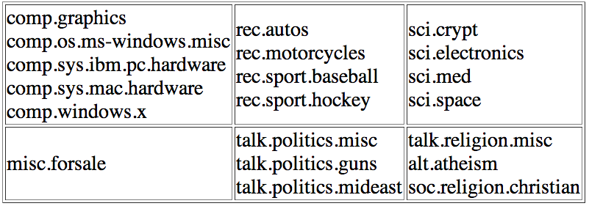
Known class hierarchies
Class organization in Newsgroup 20 Text Classification Data
http://qwone.com/~jason/20Newsgroups/

Slide 29
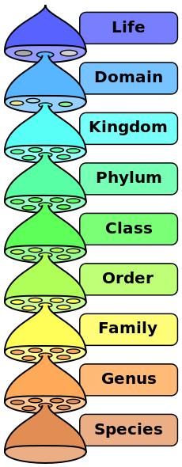
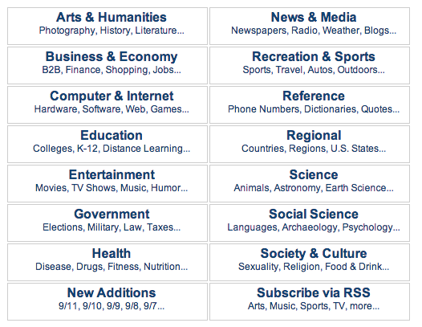
Known / Built Class hierarchy
Biological Classification
Yahoo! Directory of the Web
http://dir.yahoo.com/
http://en.wikipedia.org/wiki/Biological_classification

Slide 30
Discovered Class Hierarchies
2
6
3
8
0
5
4
9
1
7

Slide 31
Discovered Class hierarchies
M
W
N
U
F
P
T
A
V
Y
S
Z
B
E
I
J
K
R
X
C
D
L
H
O
G
Q

Slide 32
Data Exploration

Slide 33
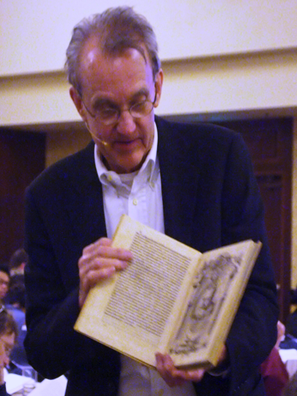
A Picture is worth a million numbers!
“Often the most effective way to describe, explore, and summarize a set of numbers – even a very large set – is to look at pictures of those numbers”
– Edward R. Tufte

Slide 34
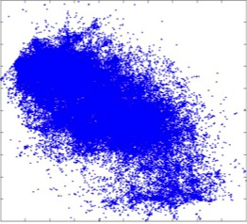
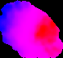
A picture is worth a thousand tables
See an entire portfolio at a glance
ID | Risk | Attrition | Credit | Behavior | Revenue | Profit
1 | 674 | 689 | 540 | 436 | 891.9 | 342.54
2 | 674 | 695 | 557 | 415 | 719.39 | 300.64
3 | 674 | 693 | 563 | 409 | 734.17 | 323.48
4 | 674 | 701 | 565 | 426 | 704.39 | 206.72
5 | 682 | 697 | 567 | 427 | 760.15 | 209.82
6 | 682 | 700 | 572 | 417 | 602.6 | 185.05
7 | 682 | 698 | 576 | 410 | 617.61 | 241.14
8 | 683 | 698 | 535 | 409 | 947.69 | 502.2
9 | 683 | 706 | 662 | 331 | 332.16 | 93.67
10 | 745 | 729 | 461 | 307 | 104.82 | 24.52
11 | 745 | 726 | 466 | 364 | 133.97 | 32.97
12 | 745 | 721 | 466 | 378 | 164.61 | 30.13
13 | 725 | 728 | 456 | 306 | 285.87 | 114.08
14 | 725 | 726 | 459 | 300 | 271.26 | 92.45
15 | 712 | 766 | 578 | 306 | 53.03 | 4.09
16 | 712 | 766 | 579 | 321 | 42.23 | -3.03
17 | 712 | 766 | 578 | 340 | 43.24 | -16.52
Topography
Overlay
Visualization should reveal the data at several levels of detail, from a broad overview to the fine structure.
Notes:
The table on the left is based on ProfitMax data. The four scores in the orange columns were used as inputs to create the topography or a “map” or a “layout” of the four dimensional space into a two dimensional space that we can see since most humans cannot “see” 4 dimensions. The two grey columns are examples of “properties of interest”.
The picture on the right has two pieces of information. (1) The topography characterized by the “shape” of the cloud. (2) The coloration or “layout” as we will call it in the future, on top shows how the property (in this case profit) is distributed over the topography.
A good analogy is that of the map of the country that can be overlaid by other things on top: population overlay, weather overlay, political map overlay, etc. While the topography is created once and fixed, one can “paint” the topography by different properties of interest. (Profit, Revenue, etc.)
The axes do not mean anything. The space is “relative”. So the only way to interpret the space is to consider two points in the original 4 dimensional space. If they are “close” to each other (by some distance measure: in this case Euclidean distance after z-scoring each dimension), then they will land up to be close to each other in the two dimensional map too. If they are far in high-D, they will be far in the low-D too.
More on how to interpret this space will come later.
The point of the slide is that looking at the table on the left (Something that most analysts do) and slicing, dicing and sorting these tables gives a very limited view of the data. But creating a visualization such as the one on the right suddenly gives a very revealing big-picture of the data. In a sense, the picture PUSHES a lot of patterns at us that we never would have thought were present in the data seen as a table. It inspires us to go look deeper in those islands and pockets of red…

Slide 35
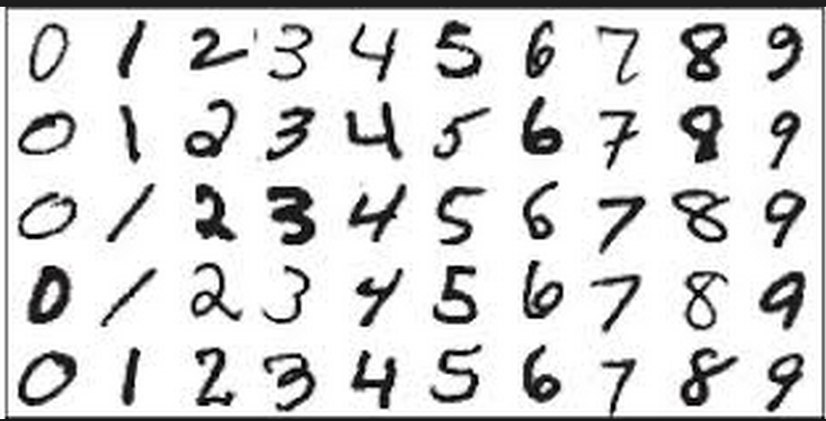
MNIST data – Handwritten digits
How does this data (as a collective) LOOK?

Slide 36

MNIST – Mean of entire data
image(reshape(mean(data), 28, 28)');
colormap(gray); axis off;

Slide 37
MNIST – Mean of each class
for c = 1:10
figure;
image(reshape(mean(train{c}), 28, 28)');
colormap(gray); axis off;
end

Slide 38
Data Exploration (Scatter Plots)

Slide 39
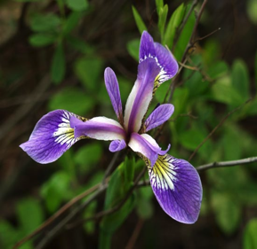
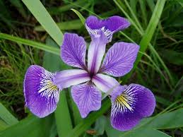
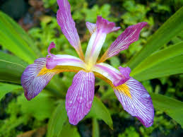
IRIS data – the “original” dataset…
4
FEATURES:
1. sepal length in cm
2. sepal width in cm
3. petal length in cm
4. petal width in cm
50
50
50
Iris Setosa
Iris Versicolour
Iris Virginica

Slide 40
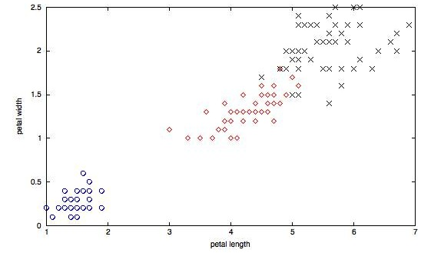
Iris – Scatter Plots + Class Labels.

Slide 41
Iris – More scatter plots

Slide 42
Data Exploration Unsupervised Projection PRINCIPAL COMPONENTS ANALYSIS

Slide 43
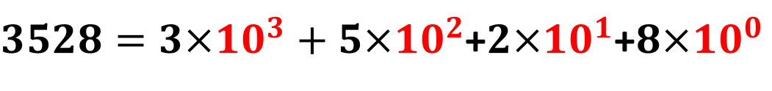
Orthogonal Bases - 101
k
UNORDERED – all bases equally important!
j
i
ORDERED – bases have decreasing importance
$3528=3×{10}^{3}+5×{10}^{2}$+$2×{10}^{1}$+$8×{10}^{0}$

Slide 44
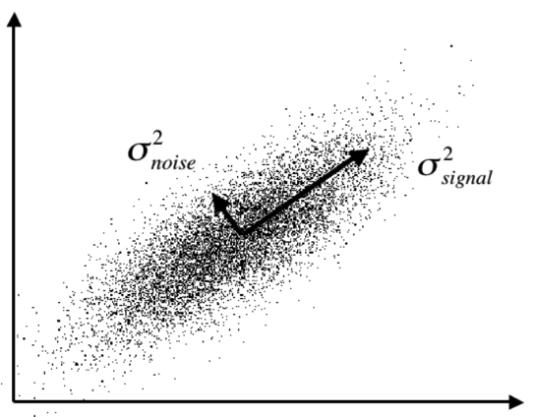
PCA: A series of ordered orthogonal projections
First Principal Component
Second Principal Component

Slide 45
Data = Signal + Noise (Iris)
SIGNAL
NOISE
4.1967 0.2406 0.0780 0.0235
Eigen Values
% age Variance Captured
Principal Components (d)

Slide 46
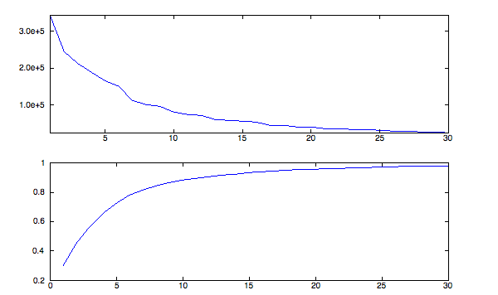
Data = Signal + Noise (MNIST)
SIGNAL
NOISE
Eigen Values
% age Variance Captured
Principal Components (d)

Slide 47
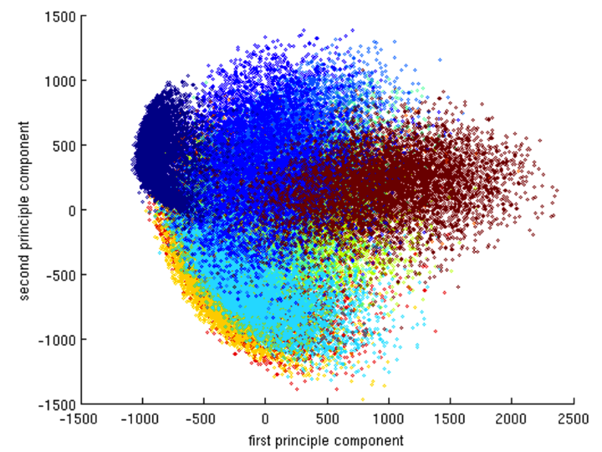
PCA on MNIST data

Slide 48
Data Exploration Supervised Projection FISHER DISCRIMINANT ANALYSIS

Slide 49
Which feature “discriminates” classes?
4
FEATURES:
1. sepal length in cm
2. sepal width in cm
3. petal length in cm
4. petal width in cm
50
50
50
Iris Setosa
Iris Versicolour
Iris Virginica

Slide 50
Best dimension to Discriminate classes?

Slide 51
Fisher Discriminant for two classes

Slide 52
Fisher Discriminant for all classes

Slide 53
Best dimension to Discriminate classes?
0.3022
0.8425
7.1051
9.3627

Slide 54
Descriptive (PCA) vs. Discriminative (Fisher)
PCA Projection – Maximizes Overall data variance
May Clobber classes in the projected space
Fisher Discriminant – Maximizes Class Separation

Slide 55
Fisher Discriminant Projection

Slide 56
Fisher Discriminant Projection
Maximize BETWEEN class separation after projection
Minimize WITHIN class separation after projection

Slide 57
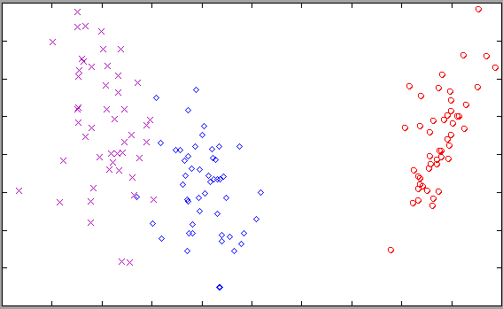
Fisher projection of IRIS

Slide 58
Fisher vs. PCA for MNIST(0,3,8)

Slide 59
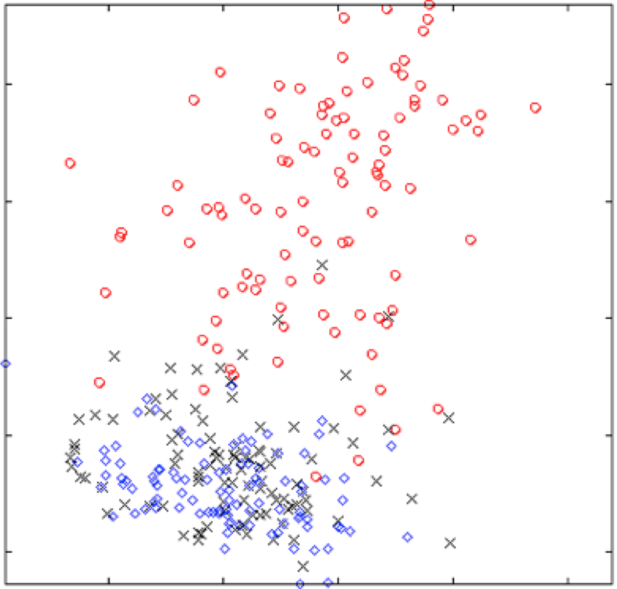
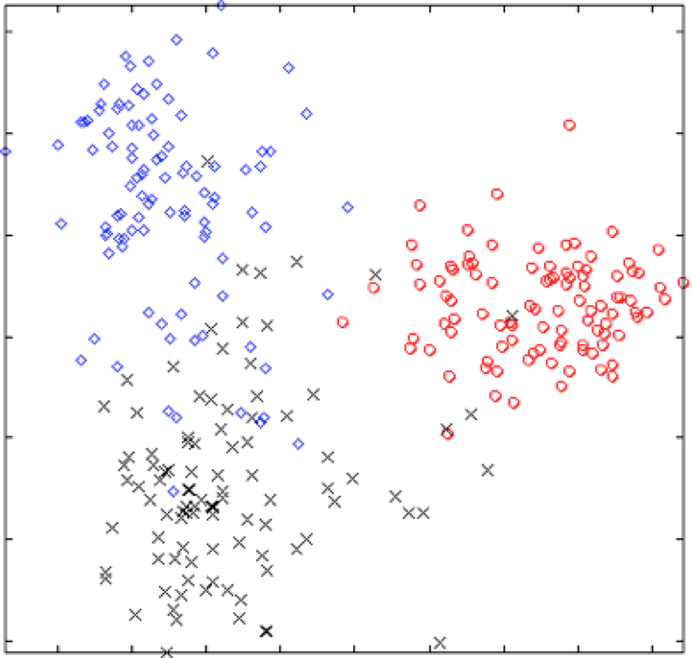
Second Principal Projection
Second Fisher Projection
First Principal Projection
First Fisher Projection
PCA Projection of classes 0, 3, 8
Fisher Projection of classes 0, 3, 8

Slide 60
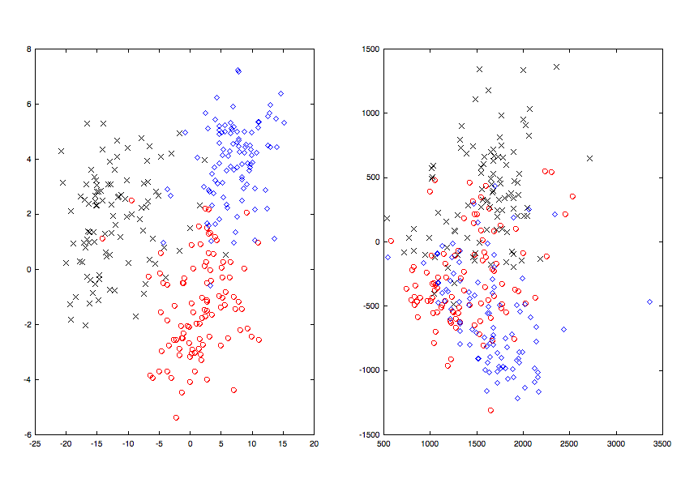
Fisher vs. PCA for MNIST(5,6,8)

Slide 61


Visualization : I Don’t Know What I Don’t Know
Rating
Revenue
Attrition

Slide 62
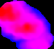
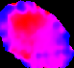



Are there really two groups or more?
Density
RETIRED
# Mortgages
FRESH COLLEGE GRADS
Bankcard Utilzn.
%Pay/Bal
Age of CB

Slide 63
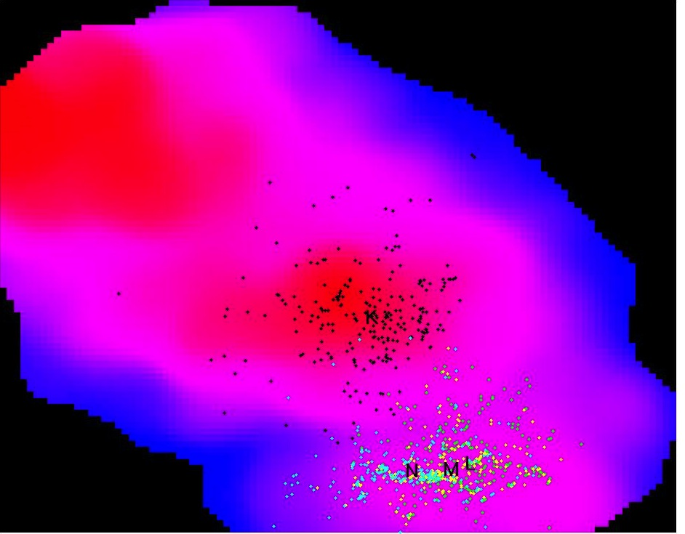
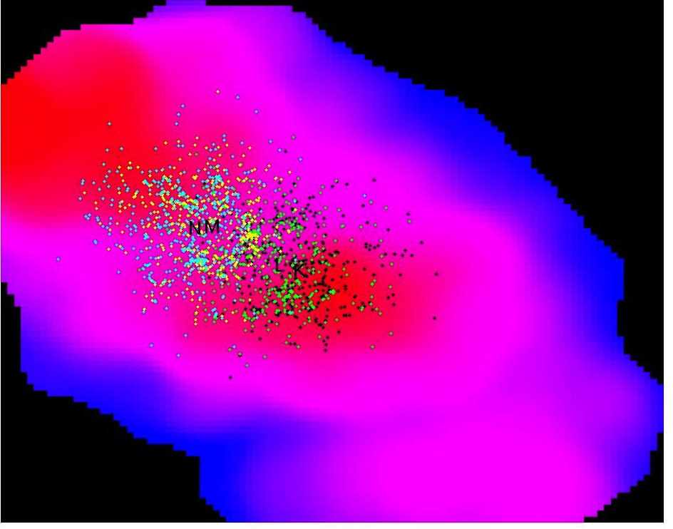
Did We Really Make the Right Decision?
Density
Density
D
C
B
A
A
B
C
D

Slide 64
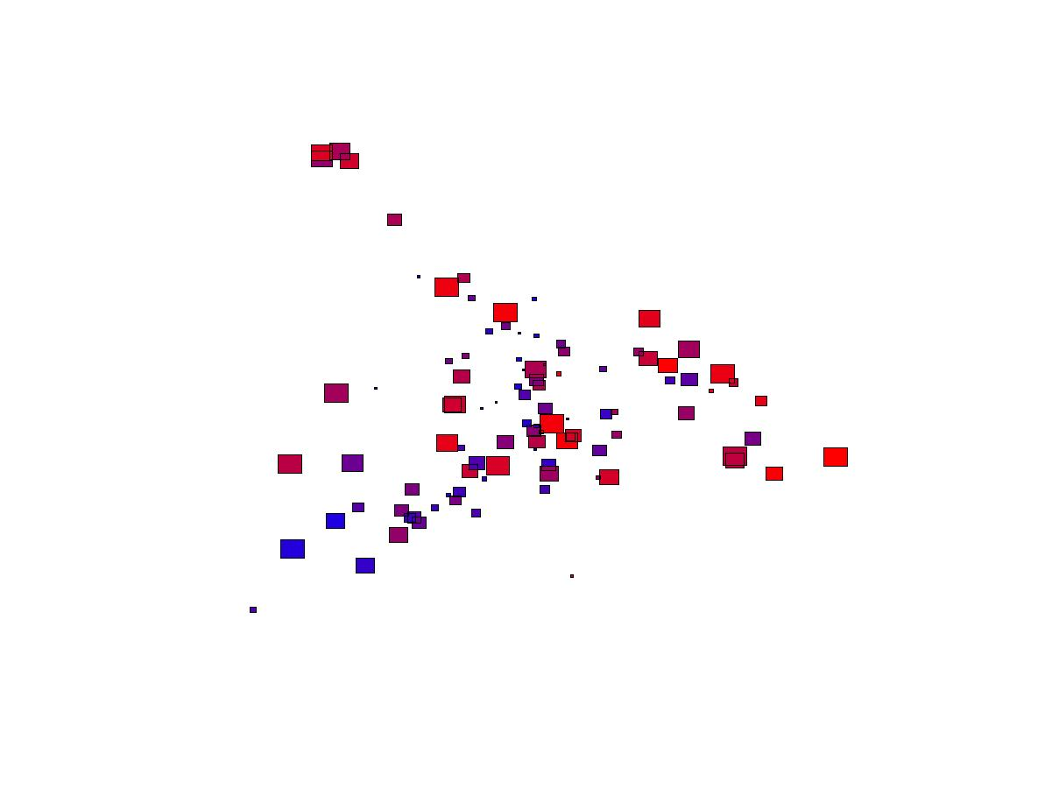
DRAMA
ACTION
COMEDY
SCI FICTION
XBOX SOFTWARE
XBOX HARDWARE
XBOX CONTROLLERS
XBOX MISC.
XBOX PLATINUM HITS
GAMECUBE SOFTWARE
GAMECUBE HARDWARE
GAMECUBE CONTROLLERS
GAMECUBE MEMORY
GAMECUBE MISC.
ACTION
TELEVISION
DRAMA
COMEDY
ANIME
ROCK/POP
FAMILY
MEMORY
INTERNAL HARD DRIVES
GRAPHICS
PC COMPONENTS
PLAYSTATION 2 SOFTWA
PS2 GREATEST HITS
PLAYSTATION 2 HARDWR
PLAYSTATION 2 MEMORY
PLAYSTATION 2 MISCEL
PLAYSTATION 2 CONTRO
LCD MONITORS
CPU'S
INK JET PRINTERS
CABLES/CONNECTORS
MULIFUNCTION PRINTER
DISHWASHER
TOP MOUNT REFRIG
DISHWASHER INSTALL
MAJOR APPL. ACCESS.
GAS RANGES
ELECTRIC RANGES
ICEMAKERS
MAJOR APPL. ACCESS.
ELECTRIC DRYERS
WASHER
SIDE BY SIDE
ELECTRIC RANGES
TOP MOUNT REFRIG

Slide 65
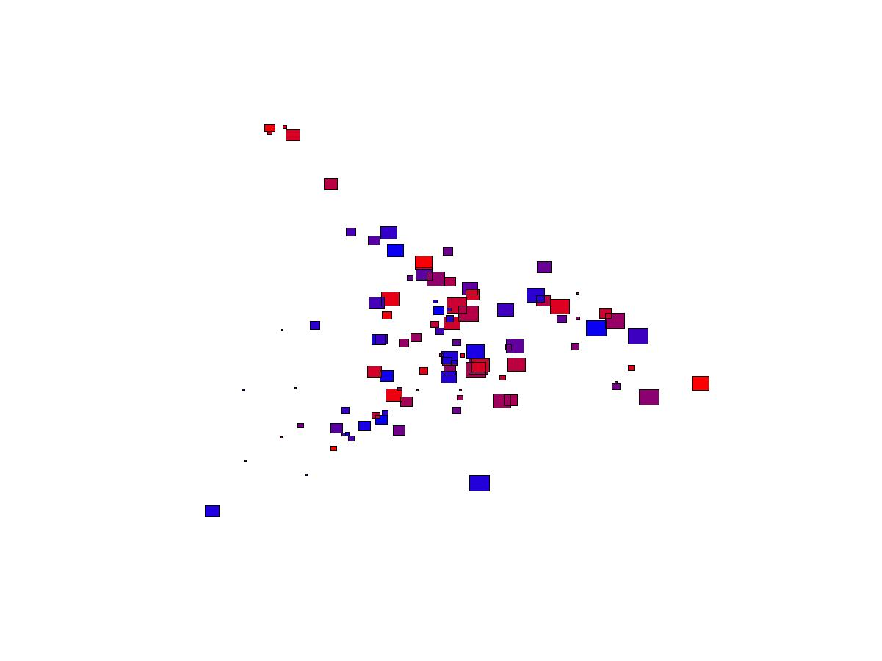
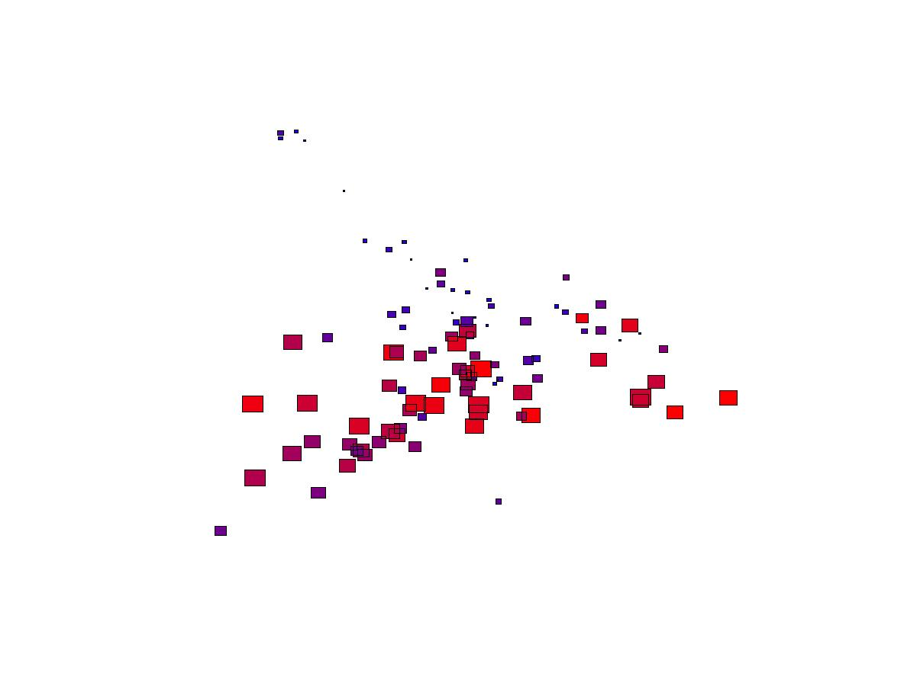
From Insights to Decisions!
Store A
Store B
Stores of the same national electronics retailer vary dramatically in the segment view

Slide 66
Feature ENGINEERING

Slide 67
Find features that “discriminate” classes
Insights
Features
Domain
Knowledge
Data
Models
Feedback
Predictions
Decision
Business Objectives
Business Constraints

Slide 68
Two Mindsets to Modeling
Model-Centric
Throw all features in!
Have enough data
Build Complex models
Feature-centric
Carefully craft features
Use Domain Knowledge
Build Simpler Models
Simple Features
Complex Model
Complex
Features
Simple
Model
The Law of Conservation of Complexity

Slide 69


Distribute Complexity Fairly
Simple Features
Complex Model
Complex
Features
Simple
Model

Slide 70
Engineer Features that make sense!
Raw Input
Time of current trans.
Place of current trans.
Time of prev. trans.
Place of prev. trans.
Derived Feature - 1
Distance(Prev→Current)
TimeLag(Prev→Current)
Derived Feature - 2
Velocity(Prev→Current)

Slide 71
Model Variance that Matters
Match(field | query)= how relevant is a field to a query
Does query length matter to overall relevance?
What about field length?

Slide 72
Model Variance that Matters
Raw Feature
Normalized Feature

Slide 73
Model deviation from the expected!

Slide 74
Debugging Machine Learning Models
Observation: Model is Unexpectedly Complex
Hypothesis: It is Compensating for some “bug”
Is there anything wrong here?

Slide 75
A closer look at the “Default” value!
If query term present in field → LOWER is BETTER
If query term absent in field → No Match = Best Match
What is the correct DEFAULT? How about -1?
If query term absent in field → field_length + K

